Slide 1

Strategic Analysis of MaxSolar
Balanced Scorecard, PESTEL Analysis, and Strategic Recommendations
MAX SOLAR 2 :
Mikael Latva
Juhani Eskola
Nasim Mahmoudi
Chippy Chandra Pillai
Redouane Afilali
Md Aman Hossain
Vaasa 2025

Slide 2
Agenda
1. Introduction to MaxSolar
2. Strategic Framework (Balanced Scorecard)
3. PESTEL Analysis
4. Scoring Model and Resource Allocation
5. Governance Model
6. Role of PMO in Portfolio Governance
7. Screening of New projects
8. Risk Categories, Tolerance Limits & Mitigation Strategies
9. Forced Ranking Matrix
10. EVM Evaluation
11. Portfolio EVM
12. Strategic Recommendations
13. Conclusion
14. Contribution of members

Slide 3
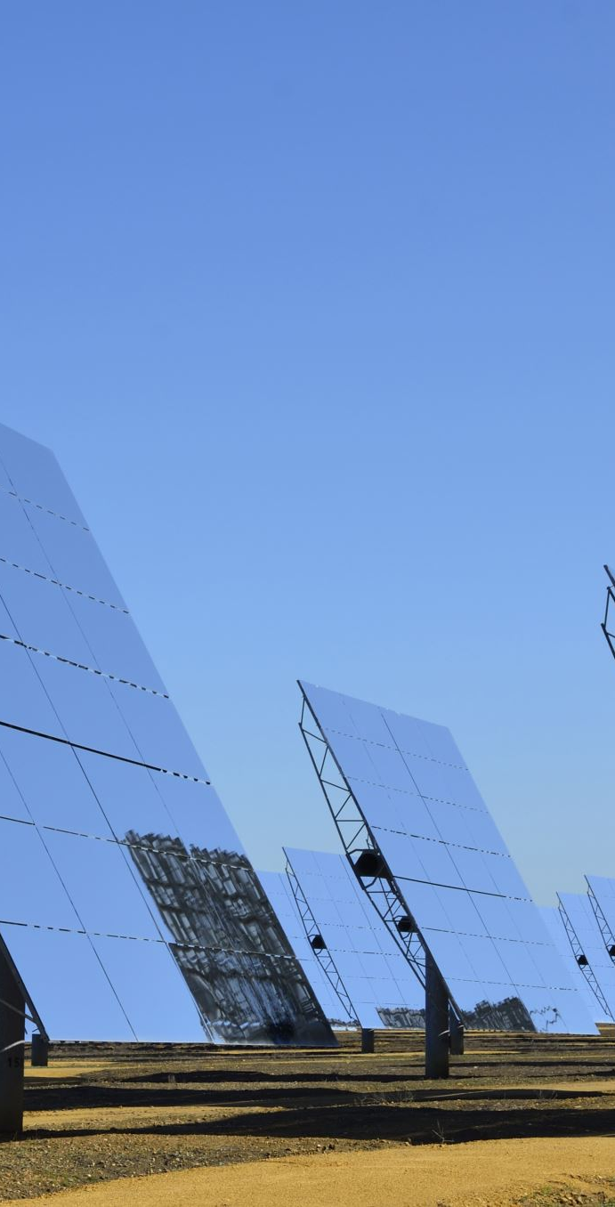
MaxSolar
MaxSolar is a company operating in the photovoltaic and energy infrastructure sector.
MaxSolar is a leading provider of integrated renewable energy solutions, encompassing the development, planning, installation, and operation of systems that amalgamate photovoltaics, wind energy, storage solutions, electric mobility, and heat supply.
MaxSolar’s strategic focus is on delivering cross‐sector energy concepts and the Project Portfolio Management (PPM) is aligned with MaxSolar’s business objectives and is aligned with the evolving dynamics of the European renewable energy market. (MaxSolar: Grüner Strom für alle, https://www.maxsolar.com/en/company/profile) MaxSolar is A Germany-based solar energy company.
MaxSolar specialises in project development, EPC, and O&M.
MaxSolar’s Mission:
Drive the transition to renewable energy.
MaxSolar’s Key Strengths:
15+ years of experience.
Diverse project portfolio (utility-scale, community solar, innovative solutions).

Slide 4
MaxSolar’s positioning in Renewable energy market
Overview of the European Renewable Energy Market
The European Union has demonstrated a robust commitment to renewable energy, with solar power emerging as the fastest‐growing energy source. It is reported that, between 2010 and 2020, the cost of solar power declined by 82%, thereby enhancing its competitive stance across the region (AP News, 2024; Wikipedia, 2024). Furthermore, in 2024 the EU achieved a significant milestone by generating more electricity from solar power than from coal, with solar contributing 11% of the electricity mix (Guardian, 2024; Reuters, 2024). Nonetheless, the recent deceleration in the growth rate of solar installations is attributed to challenges such as ageing power grids and diminished incentives for rooftop solar installations following a decline in energy prices (Energy, 2024).
Competitive Landscape
The European solar market is highly competitive, comprising both well‐established companies and rapidly expanding enterprises. For instance, Menlo Electric, a Polish solar panel wholesaler, recorded an annual growth rate of 830.8% between 2020 and 2023, which underlines the intensity of competition within the sector (Grand View Research, 2024; Reuters, 2024; Financial Times, 2024). Additionally, the market faces challenges such as overcapacity and price reductions, prompting firms to diversify their procurement strategies and explore emerging markets (Financial Times, 2024).
MaxSolar’s Strategic Positioning
MaxSolar’s comprehensive approach to renewable energy uniquely positions it within the market. By integrating various renewable technologies and focusing on innovative, cross‐sector solutions, MaxSolar distinguishes itself from competitors who may specialise exclusively in photovoltaic installations. This strategy is in keeping with the EU’s Solar Energy Strategy, which aims to increase solar capacity to nearly 600 GW by 2030, thereby highlighting the need for diverse and integrated energy solutions (Foreign Policy, 2024; Wikipedia, 2024).

Slide 5

Strategic Framework (Balanced Scorecard)
Definition of Balanced Scorecard
Balanced scorecard (BSC) is a framework for PPM. It provides a clear foundation to categorize and evaluate the projects and other initiatives.
It aligns PPM to organization vision and strategic framework.

Slide 6
Strategic Framework (Balanced Scorecard)
MaxSolar vision
Become recognized leader in transition to renewable energy
MaxSolar mission
Drive the transition to renewable energy
MaxSolar strategic themes
Market leader in renewable energy provider
Position as preferred and loyal partner
Deliver as per your commitments
Attract talents and be recognized on the professionalism
MaxSolar business from four perspectives
Financial: “To succeed financially, how should we appear to our shareholders”
Revenue growth
Profit margins
Customer: “To achieve our vision, how should we appear to our customers”
Customer satisfaction
Market share
Internal Processes: “To satisfy our shareholders and customers, what business processes must we excel at”
Efficiency
Project timelines
Learning & Growth: “ To achieve our vision, how will we sustain our ability to change and improve?”
Employee development and talent attraction
R&D

Slide 7
MaxSolar: Balanced Scorecard
 | Objectives | Measures | Targets | Initiatives
Financial |  | Revenue from the renewable energy projects | Achieve 20% growth in revenue | Partnership program to align sales efforts, tools, resources and R&D data across the ecosystem.
 |  | Revenue margin | Maintain 15% profit margin
Customer |  | NPS | Achieve 80+ scoring | “MaxSolar family” loyalty program launch in the major markets.
 |  | Increase in customer awareness | Reach 23% market share
Internal processes |  | Project timelines | Increase efficiency by 15% | Lean Six Sigma roll-out to entire delivery organization.
L&G |  | Employee skills | Upskill employees on renewable technologies 2 hours learning activities on weekly basis | Launch recruitment program in higher education institutions “Go to the NEW”(program (investment program to new renewable energy factory)
 |  | R&D investments | 15% increase in yearly investment plan
Market leader in renewable energy provider
Position as preferred and loyal partner
Deliver as per your commitments
Attract talents and be recognized on the professionalism

Slide 8
PESTEL Analysis
Political: Government policies, regulatory environment.
Economic: Economic growth, energy prices, funding.
Social: Public awareness, community engagement.
Technological: Innovation, digitalization, R&D.
Environmental: Climate change, land use, weather.
Legal: Compliance, intellectual property, contracts.

Slide 9

PESTEL Opportunities and Threats
Opportunities:
Supportive policies, economic growth, technological advances.
Threats:
- Regulatory hurdles, inflation, community resistance.

Slide 10
MaxSolar Project Portfolio Scoring Model - Integrated Renewable Energy Solutions and Project Portfolio Management at MaxSolar
Based on a synthesis of exemplary project portfolio scoring systems used by real-world organisations in energy, software, and government sectors​​​ formulated Project Portfolio Scoring Model for MaxSolar enterprise in the renewable energy sector

Slide 11
MaxSolar Project Portfolio Table for Proposed Project Portfolio Scoring Model
To evaluate and prioritise projects
Table presents MaxSolars Project Portfolios for for proposed scoring model tailored along both MaxSolar’s strategic imperatives and the current market environment in the field of the energy related business
MaxSolar Project Portfolio Table
 | NPV (Relative) | Risk (Relative) | Estimated Investment (€M) | Expected IRR (%) | Strategic Fit (1-10) | ESG Contribution (1-10)
Agri-PV Pilot | -0.75 | 0.75 | 5 | 11 | 9 | 10
Digital Grid Tools | 0.75 | 0.75 | 9 | 7 | 7 | 7
Battery Storage R&D | -0.75 | -0.75 | 4 | 13.5 | 8 | 9
Eastern Europe Entry | 0.75 | -0.75 | 3 | 6.5 | 6 | 6
O&M Automation | 0 | 0 | 2.5 | 9 | 8 | 7
EV Infrastructure | 0.5 | -0.5 | 1.5 | 8 | 7 | 8
Solar + Heat Hybrid | -0.25 | 0.25 | 3.5 | 10 | 8 | 9

Slide 12
Proposed Project Portfolio Scoring Model for MaxSolar
Portfolio Scoring Model provides
Strategic selection
Evaluation
Prioritisation of projects
In line with the firm’s
Growth
Sustainability
Innovation imperatives
MaxSolar Project Portfolio Scoring Model
Selection Criterion | 1 Point | 5 Points | 10 Points | Kill Condition
1. Strategic Fit | Aligns with 1 corporate strategy (e.g., cost reduction) | Aligns with 2–3 strategic priorities | Aligns with ≥4 strategic goals (e.g., solar expansion, digitalisation, ESG) | Kill if not aligned with any strategic goal unless a regulatory/joker- project
2. Competitive Advantage | Existing market already saturated with ≥3 similar offerings | Moderate differentiation; 1–2 competitors in market | Unique value proposition; no known direct competition | No
3. Market Attractiveness | Project targets a shrinking or low-growth regional segment | Project maintains current market position | Project opens access to high-growth, high-margin markets | No
4. Technological Feasibility | Requires unfamiliar, unproven, or untested tech; high external dependency | Leverages moderately familiar technologies; some outsourcing needed | Technologically mature and internally well-understood | Kill if domain completely unknown and high-risk unless “joker”/mandatory
5. Environmental & Social Impact | No measurable CO₂ savings or ESG alignment | Indirect impact, moderate ESG relevance | Direct measurable CO₂ reduction, biodiversity gain, or community benefit | No
6. Financial Performance (IRR) | IRR < 6%; uncertain profitability | IRR 6%–10%; modest returns | IRR > 10%; strong commercial case | Kill if IRR < 6% unless strategic breakthrough or required for license to operate
7. Risk Exposure | ≥3 major risk areas (e.g., regulatory, reputational, financial, operational) | 1–2 moderate risks | Minimal exposure; strong controls in place | Kill if legal or reputational risks are deemed unmanageable
8. Implementation Capacity | Requires >300 person-months or extensive subcontracting | Requires 200–300 person-months | Requires <200 person-months; well within internal delivery capability | No
9. Portfolio Balance Contribution | Increases imbalance (e.g., overloads transformation segment or region) | Maintains existing balance | Optimises underrepresented bucket (e.g., maintenance, strategic breakthrough) | No
10. Innovation & Knowledge Capital | No meaningful learning or patent/IP gain | Moderate learning; industry standard tech | Generates new intellectual property or internal competencies | No

Slide 13
Strategic Portfolio Buckets (Suggested Distribution)
Special Cases
Joker Projects receive an automatic 51 points and are used sparingly for:
  Regulatory mandates (e.g., EU Energy Efficiency Directive compliance).
  Projects critical to business continuity or safety.
  Transformational R&D with clear executive endorsement.
Strategic Portfolio Buckets (Suggested Distribution)
Bucket | Definition | Target Share of Budget
Regulatory & Compliance | Legal obligations, grid code compliance, safety standards | As required
Maintenance & Efficiency | Cost-saving upgrades, digitalisation of existing infrastructure | 20%
Strategic Growth | Solar farm expansions, storage integration, market entry | 40%
Innovation & R&D | Battery tech, hydrogen-PV hybrids, AI forecasting for grid loads | 20%
Strategic Breakthroughs | Highly uncertain but potentially transformative tech (e.g., agri-PV, VPPs) | 10%
ESG & Community Projects | Social value creation, biodiversity, local partnerships | 10%

Slide 14
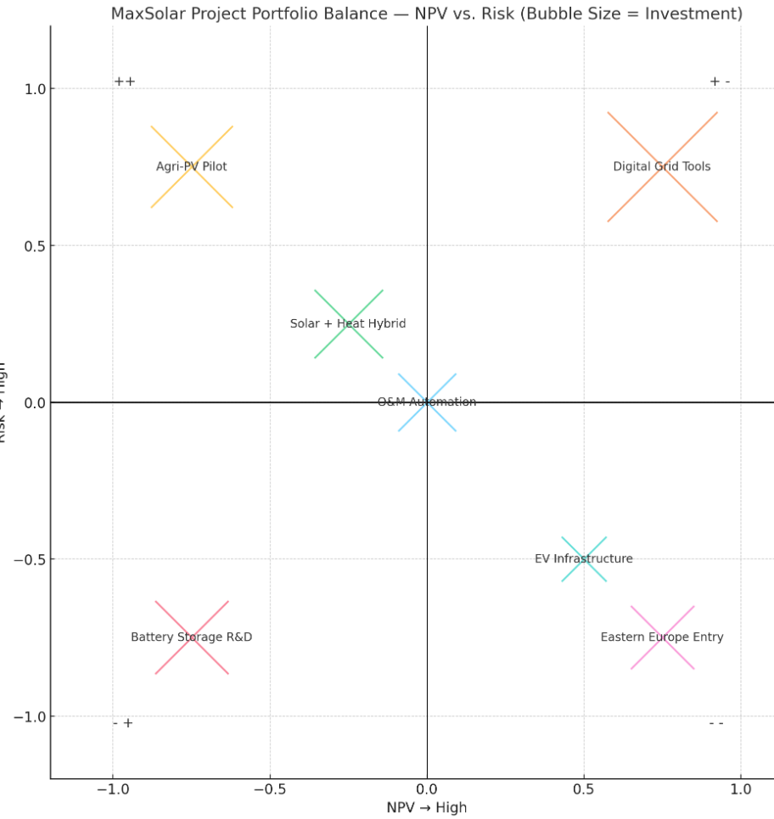
NPV vs. Risk portfolio balance chart, adapted for MaxSolar. The chart presents hypothetical projects represented as variable sized crosses Presenting strength of each project
MaxSolar Project Portfolio Balance Chart (NPV vs. Risk), featuring specific (hypothetical) project names
Agri-PV Pilot: Promising low-risk, high-return initiative.
Digital Grid Tools: Low risk but with modest financial value.
Battery Storage R&D: High-potential yet risk-intensive.
Eastern Europe Entry: Strategic market expansion with high uncertainty.
O&M Automation: Centrally positioned, balanced project.
EV Infrastructure: Emerging market, moderate investment with some risk.
Solar + Heat Hybrid: Technologically feasible, aligned with sustainability trends.
X-axis indicates the Net Present Value (NPV) from low (left) to high (right).
Y-axis indicates Risk from low (top) to high (bottom).

Slide 15
Portfolio Evaluation Charts
To visualise and balance MaxSolar’s projectportfolio
MaxSolar Project Portfolio Table
Project Name | NPV (Relative) | Risk (Relative) | Estimated Investment (€M) | Expected IRR (%) | Strategic Fit (1-10) | ESG Contribution (1-10)
Agri-PV Pilot | -0.75 | 0.75 | 5 | 11 | 9 | 10
Digital Grid Tools | 0.75 | 0.75 | 9 | 7 | 7 | 7
Battery Storage R&D | -0.75 | -0.75 | 4 | 13.5 | 8 | 9
Eastern Europe Entry | 0.75 | -0.75 | 3 | 6.5 | 6 | 6
O&M Automation | 0 | 0 | 2.5 | 9 | 8 | 7
EV Infrastructure | 0.5 | -0.5 | 1.5 | 8 | 7 | 8
Solar + Heat Hybrid | -0.25 | 0.25 | 3.5 | 10 | 8 | 9
ROI vs. Risk for reward–exposure clarity.
Strategic Fit vs. Time to Market to manage long-term vs. short-term wins.
Carbon Impact vs. Resource Demand for environmental efficiency insights.

Slide 16
MaxSolar Project Portfolio Evaluation: Score – Ranking
MaxSolar Project Portfolio Evaluation: Score - Ranking
 | Agri-PV Pilot | Digital Grid Tools | Battery Storage R&D | Eastern Europe Entry | O&M Automation | EV Infrastructure | Solar + Heat Hybrid
1. Strategic Alignment | 10 | 5 | 10 | 5 | 10 | 5 | 10
2. Competitive Advantage | 10 | 5 | 5 | 10 | 5 | 10 | 5
3. Market Attractiveness | 10 | 5 | 5 | 10 | 5 | 10 | 10
4. Technological Feasibility | 10 | 10 | 5 | 5 | 10 | 10 | 10
5. Environmental & Social Impact | 10 | 5 | 9 | 6 | 7 | 8 | 9
6. Financial Performance (IRR) | 10 | 5 | 10 | 5 | 5 | 5 | 10
7. Risk Exposure | 10 | 10 | 5 | 5 | 10 | 10 | 10
8. Implementation Capacity | 10 | 5 | 10 | 10 | 10 | 10 | 10
9. Portfolio Balance Contribution | 10 | 5 | 5 | 10 | 5 | 10 | 10
10. Innovation & Knowledge Capital | 10 | 5 | 10 | 10 | 5 | 5 | 10
Total Score | 100 | 60 | 74 | 76 | 72 | 83 | 94
Priority Rank | 1 | 7 | 5 | 4 | 6 | 3 | 2
MaxSolar Project Portfolio Balance Chart (NPV vs. Risk), featuring specific (hypothetical) project names
Agri-PV Pilot: Promising low-risk, high-return initiative.
Digital Grid Tools: Low risk but with modest financial value.
Battery Storage R&D: High-potential yet risk-intensive.
Eastern Europe Entry: Strategic market expansion with high uncertainty.
O&M Automation: Centrally positioned, balanced project.
EV Infrastructure: Emerging market, moderate investment with some risk.
Solar + Heat Hybrid: Technologically feasible, aligned with sustainability trends.

Slide 17
Recommendation Summary Summary for MaxSolar’s Strategic Project Portfolio
Recommendation Summary
Priority | Project Name | Action
1 | Agri-PV Pilot | Immediate prioritisation and resource commitment
2 | Solar + Heat Hybrid | Greenlight with targeted innovation funding
3 | Eastern Europe Entry | Proceed cautiously with phased investment
4–5 | Battery Storage R&D, O&M Automation | Monitor, revalidate feasibility milestones
6 | EV Infrastructure | Reassess if bundling options or new partners emerge
7 | Digital Grid Tools | Reposition as a support module within larger initiative

Slide 18
MaxSolar Resource Allocation Plan
Mathematical Framework Applied Allocation: MaxSolar Project Portfolio
The model has been applied to MaxSolar’s seven prioritised strategic projects
The resulting allocation, based on computed weights and normalised shares
MaxSolar Resource Allocation Plan
Project Name | Estimated Investment (€M) | Priority Rank | Weight | Allocated Resources (%)
Agri-PV Pilot | 5 | 1 | 1 | 38.57
Solar + Heat Hybrid | 3.5 | 2 | 0.5 | 19.28
Eastern Europe Entry | 3 | 3 | 0.33333… | 12.86
Battery Storage R&D | 4 | 4 | 0.25 | 9.64
O&M Automation | 2.5 | 5 | 0.2 | 7.71
EV Infrastructure | 1.5 | 6 | 0.16666… | 6.43
Digital Grid Tools | 9 | 7 | 0.142856 | 5.51

Slide 19
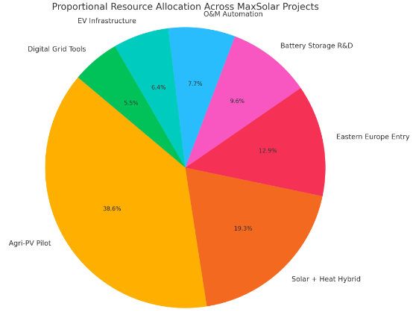
MaxSolar Resource Allocation Plan

Slide 20
Portfolio-Level Observations
At a portfolio level, several key observations emerge.
All top-tier projects, including Agri-PV Pilot, Solar + Heat Hybrid, and Eastern Europe Entry,scored highly, thereby reinforcing a strong linkage between strategic objectives and project execution.
ESG impact remains a pivotal differentiator, with projects that prioritise sustainability achieving markedly higher scores.
The projects that exhibit medium or uncertain technical feasibility tend to be penalised unless their strategic value adequately offsets the attendant risks.
There is a clear correlation between innovation potential and overall project score, with initiatives lacking in distinct innovative qualities, such as Digital Grid Tools, performing less favourably.

Slide 21
Discussion and Implications
Indications
The applied model reinforces MaxSolar’s strategic commitment to prioritising initiatives that deliver the highest organisational and societal impact.
The Agri-PV Pilot, scoring top in strategic alignment, innovation, and ESG performance, receives the largest allocation.
Solar + Heat Hybrid, also highly ranked, benefits from a substantial yet proportionately smaller share.
Lower-priority projects, such as Digital Grid Tools, though still receiving resources, are clearly identified as secondary, thereby encouraging their integration within broader programmes rather than being pursued in isolation.
Conclusion
The resource allocation framework adopted by MaxSolar exemplifies a balanced and academically grounded method for aligning strategic intent with operational capacity.
The use of inverse-rank proportionality, informed by MCDA principles, ensures that high-impact projects receive the emphasis they merit, while safeguarding the inclusion and monitoring of emerging initiatives.
This methodology offers both analytical rigour and practical applicability in the management of complex project portfolios in the renewable energy sector.

Slide 22
Scoring Model
Perspective | Strategic Goal | Weight | Score (1-10) | Weighted Score
Financial | Achieve 20% annual revenue growth | 20% | 8 | 1.6
Financial | Maintain 15% profit margin | 15% | 7 | 1.05
Customer | Achieve NPS of 80+ | 15% | 9 | 1.35
Customer | Expand market share by 10% | 10% | 6 | 0.6
Internal Processes | Reduce project development timelines by 15% | 15% | 7 | 1.05
Internal Processes | Improve operational efficiency with advanced technologies | 10% | 8 | 0.8
Learning & Growth | Invest in employee training and development | 10% | 7 | 0.7
Learning & Growth | Increase R&D spending by 10% | 5% | 6 | 0.3
Total |  | 100% |  | 7.45

Slide 23
Scoring model
Variable | Weight | Rationale
Strategic Fit | 40% | The primary goal is to ensure the portfolio aligns with MaxSolar’s strategy.
Project Termination Quality (PTQ) | 30% | High PTQ ensures resources are not wasted on misaligned projects.
Senior Management Involvement (SMI) | 20% | SMI is critical for enforcing termination decisions and strategic alignment.
Control Variables | 10% | Factors like portfolio budget and project size may influence outcomes.

Slide 24
Scoring model
Variable | Score (1-7) | Weight | Weighted Score
Strategic Fit | 6.0 | 40% | 2.4
Project Termination Quality (PTQ) | 5.5 | 30% | 1.65
Senior Management Involvement (SMI) | 5.0 | 20% | 1.0
Control Variables | 4.0 | 10% | 0.4
Total |  | 100% | 5.45

Slide 25
Scoring model
Strategic Fit: A score of 6.0 indicates strong alignment with MaxSolar’s corporate strategy.
PTQ: A score of 5.5 suggests effective project termination processes, but there is room for improvement.
SMI: A score of 5.0 indicates moderate senior management involvement, which is likely beneficial but could be optimized.
Overall Score: A total weighted score of 5.45 (out of 7) suggests that MaxSolar’s project portfolio is performing well but could improve in areas like PTQ and SMI.

Slide 26
Resource Allocation
Top-Down Approach:
Market Expansion: 30%
Operational Efficiency: 25%
Customer Experience: 20%
R&D and Innovation: 15%
Employee Development: 10%

Slide 27
Governance Model
Five Components:
1. Strategic Direction: Vision, mission, and goals.
2. Performance Monitoring: KPIs and dashboards.
3. Decision authority :Resource Allocation and Budget alignment with priorities.
4. Risk Management: PESTEL-based risk mitigation.
5. Accountability and Culture: Clear ownership and innovation culture.

Slide 28

Role of PMO in Portfolio Governance
Portfolio Standard
PMO needs to ensures the standardized PPM methodologies, process and tools for tracking Project Progress
Standardize evaluation criteria(Scoring model, checklists ) to filter out non-viable projects
Portfolio Oversight
Coordinate across projects, programs and portfolios
standardizes governance, reporting and decision making across all levels
Strategic Alignment
Ensures the projects align with Max’s solar renewable energy strategy, sustainability goals, and regulatory requirement.
Initial screening of the project(strategic fit, feasibility check, Risk assessment )
Assessing project feasibility, ensuring compliance with green energy regulations
Prioritizing investments that maximize the company’s impact on the renewable energy market.
Resource Management
Manage resources across the projects as well as operations to prevent the bottlenecks.
maintain the skill matrix and reallocates the teams based on Project priorities
Governance
Establish a governance Framework that guides project approvals, investment and risk management.
Assist Executives with GO/NO-GO Decision

Slide 29
Role of PMO in Portfolio Governance
Communication Management
PMO must acts as communication hub between project teams, stakeholders/Investors and Executives
Report on achievements to stakeholders and investors
Integrated Data and Performance Tracking
Host a centralized Solar portfolio dashboard for tracking project progress, Maintenances and performance
Integrates with the Companies IT system and tools(IOT/sensor data ) from solar panel real time monitoring and predictive maintenance
Benefit realization and Value tracking
Validate the completed product delivers the project goals
Compare projected vs actual ROI
Continuous Improvement and Innovation
Capture lessons learned from the past experience (Challenges, bottlenecks, or efficiency improvements) and use those insights for future to drive continuous improvement

Slide 30
Screening of New Projects
Initial Evaluation of the "Next-Gen Secure Digital Service Platform"
Candidate Project Overview
Project Name: Next-Gen Secure Digital Service Platform
Sponsor: CIO
Business Objective:
Develop a secure, analytics-driven platform to streamline operations and enhance customer value.
Address shareholder concerns over outdated infrastructure.
Key Metrics:
Budget: 12M€ (phased: 1M€, 3.5M€, 7.5M€) + 500k/yr DevOps.
Timeline: 48 months.

Slide 31
Level 1 (L1) Screening Using MaxSolar’s Scoring Model (Align with Strategic Buckets: Growth, Sustainability, Innovation)
Criteria | Score (1-5) | Rationale
Strategic Fit | 4 | Aligns with digital transformation goals but limited direct link to renewable energy core.
Financial ROI | 3 | High upfront cost; ROI depends on operational efficiencies (long payback).
Risk Level | 3 | Moderate (technical complexity, phased funding risks).
Innovation Potential | 5 | High (advanced analytics, security features).
Business Value | 5 | Tangible: €9M revenue by Year 7 (from case study data). Intangible: Enhances shareholder trust and positions MaxSolar as a tech innovator.
ESG Impact | 2 | Indirect (supports operational sustainability, not core renewable energy).
Total Score: 22/30 (Threshold for "Go": ≥24)
Conclusion: "Not Go" at L1 due to:
  Marginal strategic alignment with MaxSolar’s renewable energy mission.
  High resource commitment vs. projected ROI.

Slide 32
Risk Management Framework
Risk Categories (aligned with PESTEL):
Resource Risks: dependency on the external resources and infrastructure.
Enviromental Risks: threat to wildlife to get harmed or damaged.
Operational Risks: Delays in project timelines.
Technological Risks: Obsolescence of energy storage solutions.
Public Relations Risks: Community resistance to large-scale solar farms.
Tolerance Limits:
Budget overruns: ≤10% of project cost.
Schedule delays: ≤15% of timeline.
Discount Rates:
2024: 8% (reflecting inflation risks).
2025: 7% (assuming stabilized supply chains).
Regulatory Risks: Blockchain and AI use can be the future threat.
Organizational Risk: longer payback time.

Slide 33
Risk Categories & Tolerance Limits
(Aligned with PESTEL and EVM Data)
Risk Category | Tolerance Limit | Discount Rate (2025-26) | Trigger Metric
Risk Category | Tolerance Limit | Discount Rate (2025-26) | Trigger Metric
Cost Overruns | CPI ≥ 0.90 | 8% | CPI < 0.85 for 2 consecutive PIs
Schedule Delays | SPI ≥ 0.95 | 6% | SPI < 0.90 + Strategic Debt >20%
Regulatory Compliance | Zero violations | 12% | New policy impact >€100k
Technology Failure | R&D budget ≤15% of BAC | 10% | Technical feasibility score <3/5
ESG Non-Compliance | Carbon impact ≤5% over target | 15% | ESG score <4/5 in scoring model

Slide 34
Top 5 Portfolio Risks & Mitigation Strategies
Risk | Project(s) Affected | Likelihood | Impact (€) | Mitigation Strategy
Strategic Debt Accumulation | Beta (€500k), Delta (€124k) | High | 624,000 | Terminate Beta; freeze Delta until rescue plan approved.
Regulatory Hurdles in Eastern Europe | New Segment, Carbon 2 | Medium | 300,000 | Partner with local legal experts; diversify markets.
Technology Maturity (AI/Blockchain) | Serve 1, IoT | High | 450,000 | Pilot phased rollout; secure tech partnerships.
Supply Chain Disruptions | Carbon 1, Delta | Medium | 200,000 | Dual-source critical components; buffer inventory.
Employee Attrition | All R&D projects | Low | 150,000 | Enhance retention packages; accelerate upskilling.

Slide 35
Risk Governance Actions
Monthly Reviews:
Track CPI/SPI and strategic debt for all projects.
Stage-Gate Approvals:
High-risk projects (e.g., Delta) require executive sign-off for next phase.
Contingency Reserves:
Allocate 10% of portfolio budget to cover ESG/compliance risks.

Slide 36

Opportunities
Planting solar panels in the ocean it is a
very high scenario because low competition.
Standing in position as market leader.
Control over service ecosystem.

Slide 37
Forced Ranking Matrix for MaxSolar Projects
(Ranked by Strategic Fit, ROI, and Risk)
•Strategic Fit: 5=Perfect alignment with MaxSolar’s mission, 1=No alignment.
•ROI Potential: 5=CPI>1.5, 1=CPI<0.7
•Risk Level: 1=Low (SPI>1.1, stable), 5=Critical (SPI<0.9 or CPI<0.6)
Project Name | Strategic Fit (1-5) | ROI (CPI-Based) | Risk (1-5) | Total Score | Rank | Decision | Budget (€)
Project Carbon 2 | 5 (ESG leader) | 4 (CPI=1.29) | 2 (Low) | 11 | 1 | ↑↑ Accelerate | 890,000
Project New Segment | 4 (Market expansion) | 4 (CPI=1.23) | 3 (Medium) | 10 | 2 | ↑ Invest | 800,000
Project Serve 1 | 4 (Operational efficiency) | 3 (CPI=1.08) | 2 (Low) | 9 | 3 | → Monitor | 720,000
Project Delta | 3 (Tech innovation) | 3 (CPI=0.95) | 4 (High) | 8 | 4 | → Pilot Phase | 400,000
Project Carbon 1 | 5 (ESG) | 2 (CPI=0.85) | 3 (Medium) | 8 | 5 | → Descope | 120,000
Project Beta | 2 (Low alignment) | 1 (CPI=0.56) | 5 (Critical) | 7 | 6 | ❌ Terminate | 390,000
Project IoT | 3 (High cost) | 2 (CPI=0.72) | 5 (Critical) | 6 | 7 | ❌ Terminate | 2,300,000
Project Delta 2 | 2 (Redundant) | 1 (CPI=0.62) | 4 (High) | 5 | 8 | ❌ Terminate | 440,000

Slide 38
How to Use This Matrix
1. Top Quartile (Score: 10-15)
Examples: Carbon 2, New Segment
Actions:
  Full funding approval
  Priority resource allocation (team, budget, tools)
  Accelerated execution (fast-track approvals, remove bottlenecks)
  Bi-weekly performance reviews (track CPI/SPI)
  2. Middle Quartile (Score: 7-9)
Examples: Serve 1, Delta
Actions:
  Conditional funding (partial budget with milestone gates)
  Stage-gate approvals (must hit CPI/SPI targets to unlock next phase)
  Monthly risk reviews (mitigate issues before escalation)
  Re-evaluate in next PI Planning (promote to Top Quartile if improved)
  3. Bottom Quartile (Score: ≤6)
Examples: Beta, IoT, Delta 2
Actions:
  Terminate or descope (free up resources)
  Reallocate funds to Top Quartile projects

Slide 39
Key EVM Metrics & Definitions
Earned Value Management (EVM) Evaluation
Planned Value (PV): Originally planned cost of the work that should have been done today.
Earned Value (EV): Amount of originally budgeted work that is completed as per today
Actual Cost (AC): Actual cost incurred.
Cost Variance (CV): EV – AC (Negative = Over Budget).
Schedule Variance (SV): EV – PV (Negative = Behind Schedule).
% Complete: (EV / BAC) × 100.
Action: Terminate projects with CPI < 1 or SPI < 0.9.
Reference: Fleming, Q. W., & Koppelman, J. M. (2016). Earned Value Project Management (4th ed.). PMI.​
Teacher-provided EVM data (workshop).

Slide 40
EVM Metrics - Project Alpha
Metric | Value | Formula/Explanation
Budget at Completion (BAC) | €200,000 | Total approved budget
Planned Value (PV) | €76,000 | Budgeted work to date
Earned Value (EV) | €84,000 | PV + Schedule Variance = 76k + 8k
Actual Cost (AC) | €90,000 | Actual spend to date
Cost Variance (CV) | -€6,000 | EV - AC = 84k - 90k (Over budget)
Schedule Variance (SV) | +€8,000 | EV - PV = 84k - 76k (Ahead of schedule)
% Complete | 42% | (EV / BAC) = 84k / 200k
Variance at Completion (VAC) | +€2,000 | BAC (200k) - EAC (198k)
Strategic Debt(Strategic Debt=∑(Cost to fix deferred work) | +€45,000
Estimated New Length | 15months | Original timeline (no change)
*EAC = AC (90k) + ETC (100k) + Strategic Debt (8k) | 214 K

Slide 41
Portfolio EVM Performance Summary
Objective: Assess cost/schedule health across all projects
Key Metrics:
  CPI = EV/AC (Cost Performance Index)
  SPI = EV/PV (Schedule Performance Index)
Thresholds:
  Green Zone: CPI/SPI ≥ 1.0
  Yellow Zone: 0.9 ≤ CPI/SPI < 1.0
  Red Zone: CPI/SPI < 0.9
# | Project Name | Budget at Completion (BAC) | Length (Months) | Planned Value (PV) | Schedule Variance (SV) | Actual Cost (AC) | Cost Variance (CV) | Earned Value (EV) | Estimated / New length (Months) | Strategic debt | Variance at Completion (VAC) | % complete | SPI | CPI | EAC
1 | Project Alpha | 200 000 € | 13 | 76 000 € | 8 000 € | 90 000 € | -6 000 € | 84 000 € | 14,4 | 45 112,8 € | -14 286 € | 42,00 % | 1,11 | 0,93 | 214 286 €
2 | Project Beta | 390 000 € | 8 | 260 000 € | -60 000 € | 250 000 € | -50 000 € | 200 000 € | 6,2 | -225 000,0 € | -97 500 € | 51,28 % | 0,77 | 0,80 | 487 500 €
3 | Project Delta | 400 000 € | 18 | 210 000 € | 15 000 € | 280 000 € | -55 000 € | 225 000 € | 19,3 | 71 111,1 € | -97 778 € | 56,25 % | 1,07 | 0,80 | 497 778 €
4 | Project Nord | 1 900 000 € | 36 | 380 000 € | -5 000 € | 365 000 € | 10 000 € | 375 000 € | 35,5 | -48 666,7 € | 50 667 € | 19,74 % | 0,99 | 1,03 | 1 849 333 €
5 | Project Sky | 220 000 € | 12 | 15 000 € | 5 000 € | 13 000 € | 7 000 € | 20 000 € | 16,0 | 95 333,3 € | 77 000 € | 9,09 % | 1,33 | 1,54 | 143 000 €
6 | Project Carbon 1 | 120 000 € | 17 | 20 000 € | 1 000 € | 31 000 € | -10 000 € | 21 000 € | 17,9 | 17 714,3 € | -57 143 € | 17,50 % | 1,05 | 0,68 | 177 143 €
7 | Project Carbon 2 | 890 000 € | 25 | 750 000 € | -30 000 € | 690 000 € | 30 000 € | 720 000 € | 24,0 | -68 233,3 € | 37 083 € | 80,90 % | 0,96 | 1,04 | 852 917 €
8 | Project Serve 1 | 720 000 € | 13 | 386 000 € | 14 000 € | 25 000 € | 375 000 € | 400 000 € | 13,5 | 3 264,2 € | 675 000 € | 55,56 % | 1,04 | 16,00 | 45 000 €
9 | Project Delta 2 | 440 000 € | 13 | 76 000 € | -39 000 € | 375 000 € | -338 000 € | 37 000 € | 6,3 | -4 576 813,7 € | -4 019 459 € | 8,41 % | 0,49 | 0,10 | 4 459 459 €
10 | Project IoT | 2 300 000 € | 40 | 140 000 € | -12 000 € | 85 000 € | 43 000 € | 128 000 € | 36,6 | -261 830,4 € | 772 656 € | 5,57 % | 0,91 | 1,51 | 1 527 344 €
11 | Project new segment | 800 000 € | 20 | 420 000 € | 34 000 € | 135 000 € | 319 000 € | 454 000 € | 21,6 | 38 514,8 € | 562 115 € | 56,75 % | 1,08 | 3,36 | 237 885 €
12 | Project Process Transformation | 320 000 € | 15 | 125 000 € | 13 000 € | 410 000 € | -272 000 € | 138 000 € | 16,6 | 197 750,7 € | -630 725 € | 43,13 % | 1,10 | 0,34 | 950 725 €
13 | Project Delta 3 | 150 000 € | 18 | 88 000 € | -2 000 € | 115 000 € | -29 000 € | 86 000 € | 17,6 | -9 117,3 € | -50 581 € | 57,33 % | 0,98 | 0,75 | 200 581 €
14 | Project Beta 2 | 275 000 € | 16 | 150 000 € | 25 000 € | 87 000 € | 88 000 € | 175 000 € | 18,7 | 45 571,4 € | 138 286 € | 63,64 % | 1,17 | 2,01 | 136 714 €

Slide 42

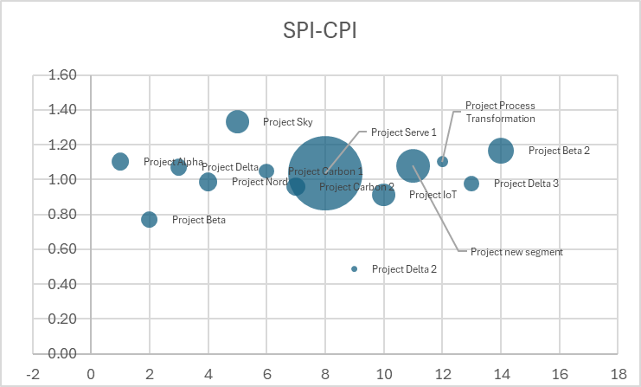
Portfolio EVM Bull’s-Eye Chart
Elimination criteria
1. Cost Performance Index (CPI)
CPI < 1 means the project is over budget (each unit of work has cost more than planned)
2. Schedule Performance Index (SPI)
CPI < 1 means the project is behind the schedule
Decision for projects to be eliminated
2. Project Beta
9 Project Delta 2
Reference: Cooper et al. (2001), pp. 145-150 (Visual portfolio tools).
PMI (2017), p. 102 (EVM for portfolios)

Slide 43
Portfolio EVM Bull’s-Eye Chart

Slide 44

Strategic Recommendations
Short-Term:
- Focus on markets with strong government support.
Invest in digital tools for operational efficiency.
Enhance customers engagement & awareness.
Long-Term:
- Expand R&D for innovative solutions (e.g., energy storage).
- Diversify geographically to reduce risks.

Slide 45

Conclusion
Key Takeaways:
- MaxSolar is well-positioned to capitalize on renewable energy trends.
- Strategic focus on financial growth, customer satisfaction, and innovation is critical.
- Proactive risk management and governance ensure long-term success.

Slide 46
References
- AXELOS. (2020). *Managing Successful Programmes (MSP)* (5th ed.).
- Cooper, R. G., et al. (2001). *Portfolio Management for New Products*. Basic Books.
- ISO 31000:2018. *Risk Management Guidelines*.
- Kaplan, R. S., & Norton, D. P. (1996). *The Balanced Scorecard*. HBP.
- Kodukula, P. (2014). *Project Portfolio Management*. J. Ross Publishing.
- PMI. (2017). *The Standard for Portfolio Management* (4th ed.).
- Teacher-provided workshop materials (2025).

Slide 47
Student Name | Student Number | Contribution in the group work
 |  | Workshop 1 | Workshop 2
Nasim Mahmoudi | 2402263 | attended | attended
Juhani Eskola | 2403897 | Not attended | attended
Chippy Chandra Pillai | 2403836 | Not attended (Half day present in class) | Attended
Md Hossain Aman | 2500637 | Not attended(Half day present in class) | Attended
Redouane Afilali | 2403366 | Not attended physically (but online) | Attended
Mikael Latva | 2303978 | Not attended | Attended

